Slide 1

LUNAR
Hanbin Baik
Hanna Jung
Hyejun Jeong

Slide 2


Domain:
An Educational Database App to Schedule the Courses
Student
Search
Enroll
Record – current
Record - history
Drop
Admin
Add students
Add Professors
Add Courses
Edit
View a student’s record
Notes:
An educational database app to schedule the courses
Students – Search
- Enroll
- Record – current
- history
- drop
Admin – add – students
- professors
- courses
- edit
- record

Slide 3
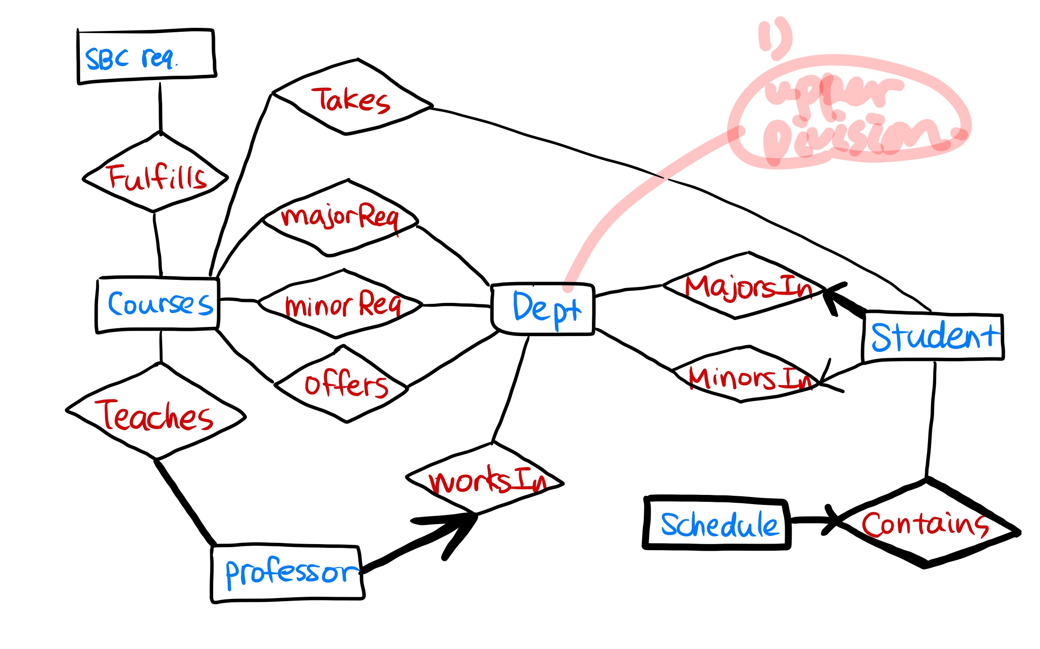
E/R Diagram:
Notes:
Domain info of your system (what sort of database app are you building?)
E/R diagram Initial set of tables with FD's Normalization done showing resulting tables Key database features in your system Demo of your system in operation (implementation should be close to being complete)

Slide 4
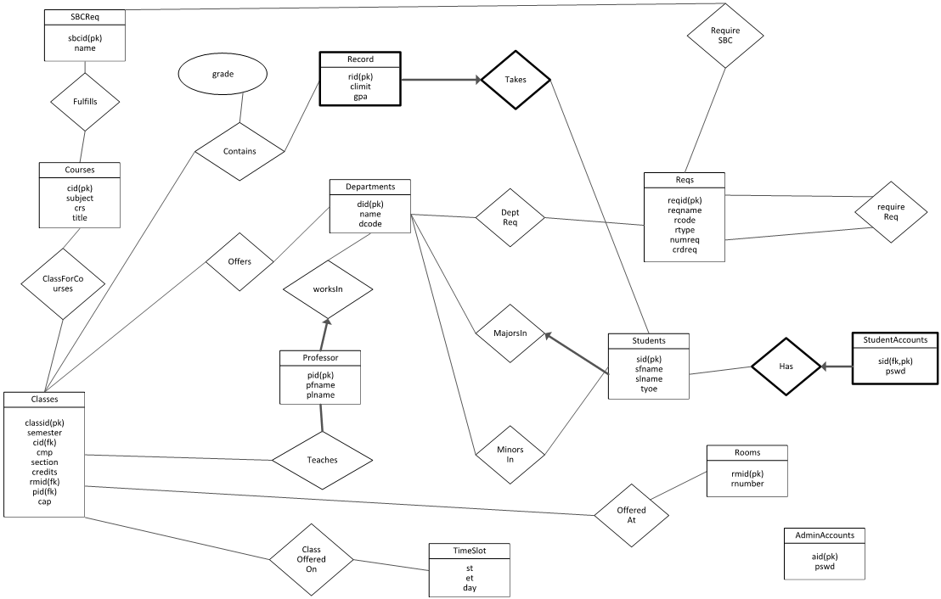
E/R Diagram:
Notes:
Domain info of your system (what sort of database app are you building?)
E/R diagram Initial set of tables with FD's Normalization done showing resulting tables Key database features in your system Demo of your system in operation (implementation should be close to being complete)

Slide 5
Functional Dependency:
BEFORE
Course (C→CJRTMNDYSEOPUA)
JRMS → T
JRMS → YSE JRMS → I
YSE → O O → YSE
I → YSEO S → YSEO
Students (I → INGCSRT)
I → N
Dept (D→DNCSPR)
N → NCSPR
N → CSP
N → CSR
D → R
Record (RS→RSTC)
-
SBCReq (I→IN)
I → N
Professors (P→PNC)
P → N
PC → N N → PC
Notes:
Domain info of your system (what sort of database app are you building?)
E/R diagram Initial set of tables with FD's Normalization done showing resulting tables Key database features in your system Demo of your system in operation (implementation should be close to being complete)

Slide 6
Functional Dependency:
AFTER
Dept (D→DNC)
D → NC
D → N N → C
D → C C → D
N → C C → N
Rooms (R→RN)
R → N N → R
Timeslot (I→IDSE)
I → DSE
Record (I→ILG)
l → LG
Students (I → IFLT)
I → FLT
SBCReq (I→IN)
I → N
Professors (I→IFL)
I → FL
Notes:
Domain info of your system (what sort of database app are you building?)
E/R diagram Initial set of tables with FD's Normalization done showing resulting tables Key database features in your system Demo of your system in operation (implementation should be close to being complete)

Slide 7
Functional Dependency:
AFTER
Classes (C→CSIMTDRPA)
C → IMTDRPA
C → IM IM → C
C → ID ID → C
C → TD TD → C
Courses (C→CSRT)
C → SRT SRT → C
C → SR SR → T
C → ST ST → R
C → RT
C → T
AdminAccounts (I → IP)
I → P
StudentAccounts (I→IP)
I → P
Notes:
Domain info of your system (what sort of database app are you building?)
E/R diagram Initial set of tables with FD's Normalization done showing resulting tables Key database features in your system Demo of your system in operation (implementation should be close to being complete)

Slide 8
Normalization:
Notes:
Domain info of your system (what sort of database app are you building?)
E/R diagram Initial set of tables with FD's Normalization done showing resulting tables Key database features in your system Demo of your system in operation (implementation should be close to being complete)

Slide 9
Key Database Features:
Admin
Log-in (Admin)
Add New Students/Professors/Courses
Edit Course Information
View Student Record
Notes:
Domain info of your system (what sort of database app are you building?)
E/R diagram Initial set of tables with FD's Normalization done showing resulting tables Key database features in your system Demo of your system in operation (implementation should be close to being complete)

Slide 10
Key Database Features:
Student
Log-in (Student)
Search Classes
Enroll Classes
View Current/History Record
Drop Classes
Notes:
Domain info of your system (what sort of database app are you building?)
E/R diagram Initial set of tables with FD's Normalization done showing resulting tables Key database features in your system Demo of your system in operation (implementation should be close to being complete)

Slide 11
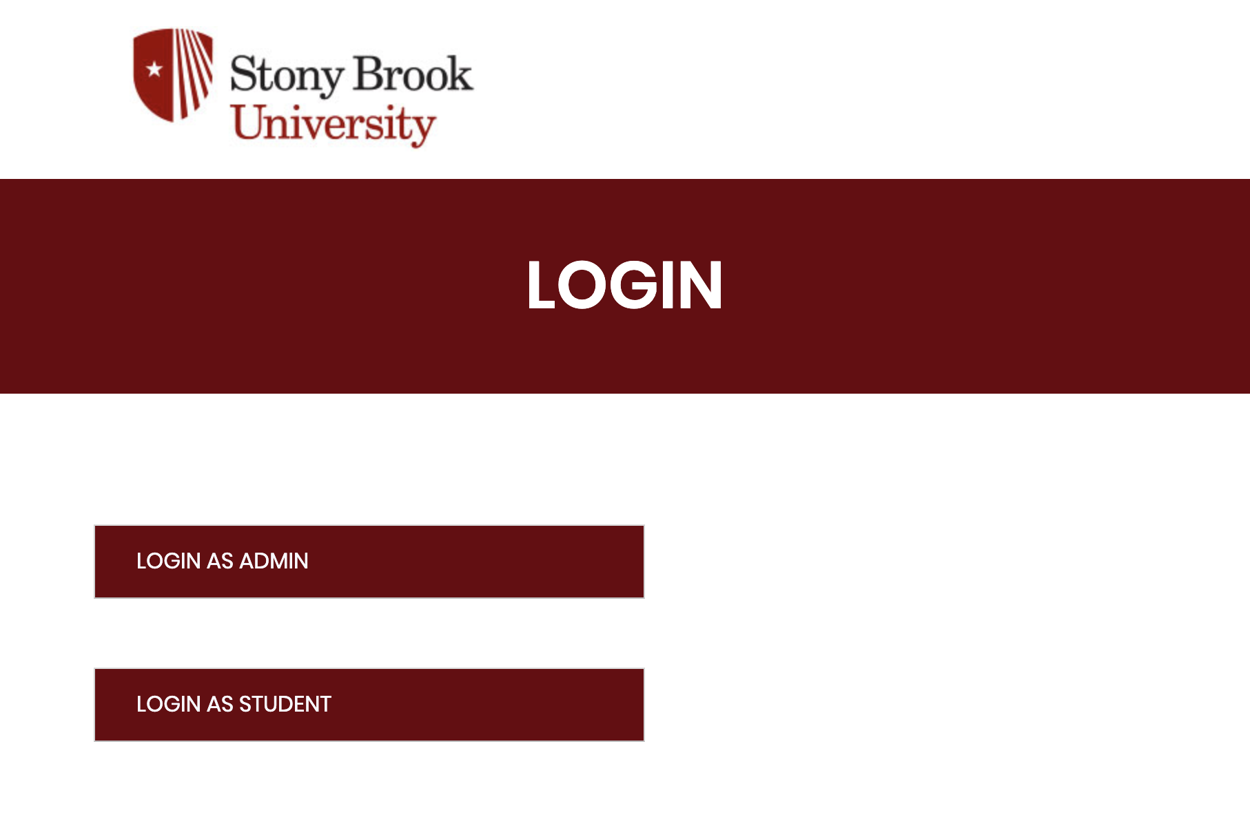
Demo:
Notes:
Domain info of your system (what sort of database app are you building?)
E/R diagram Initial set of tables with FD's Normalization done showing resulting tables Key database features in your system Demo of your system in operation (implementation should be close to being complete)

Slide 12
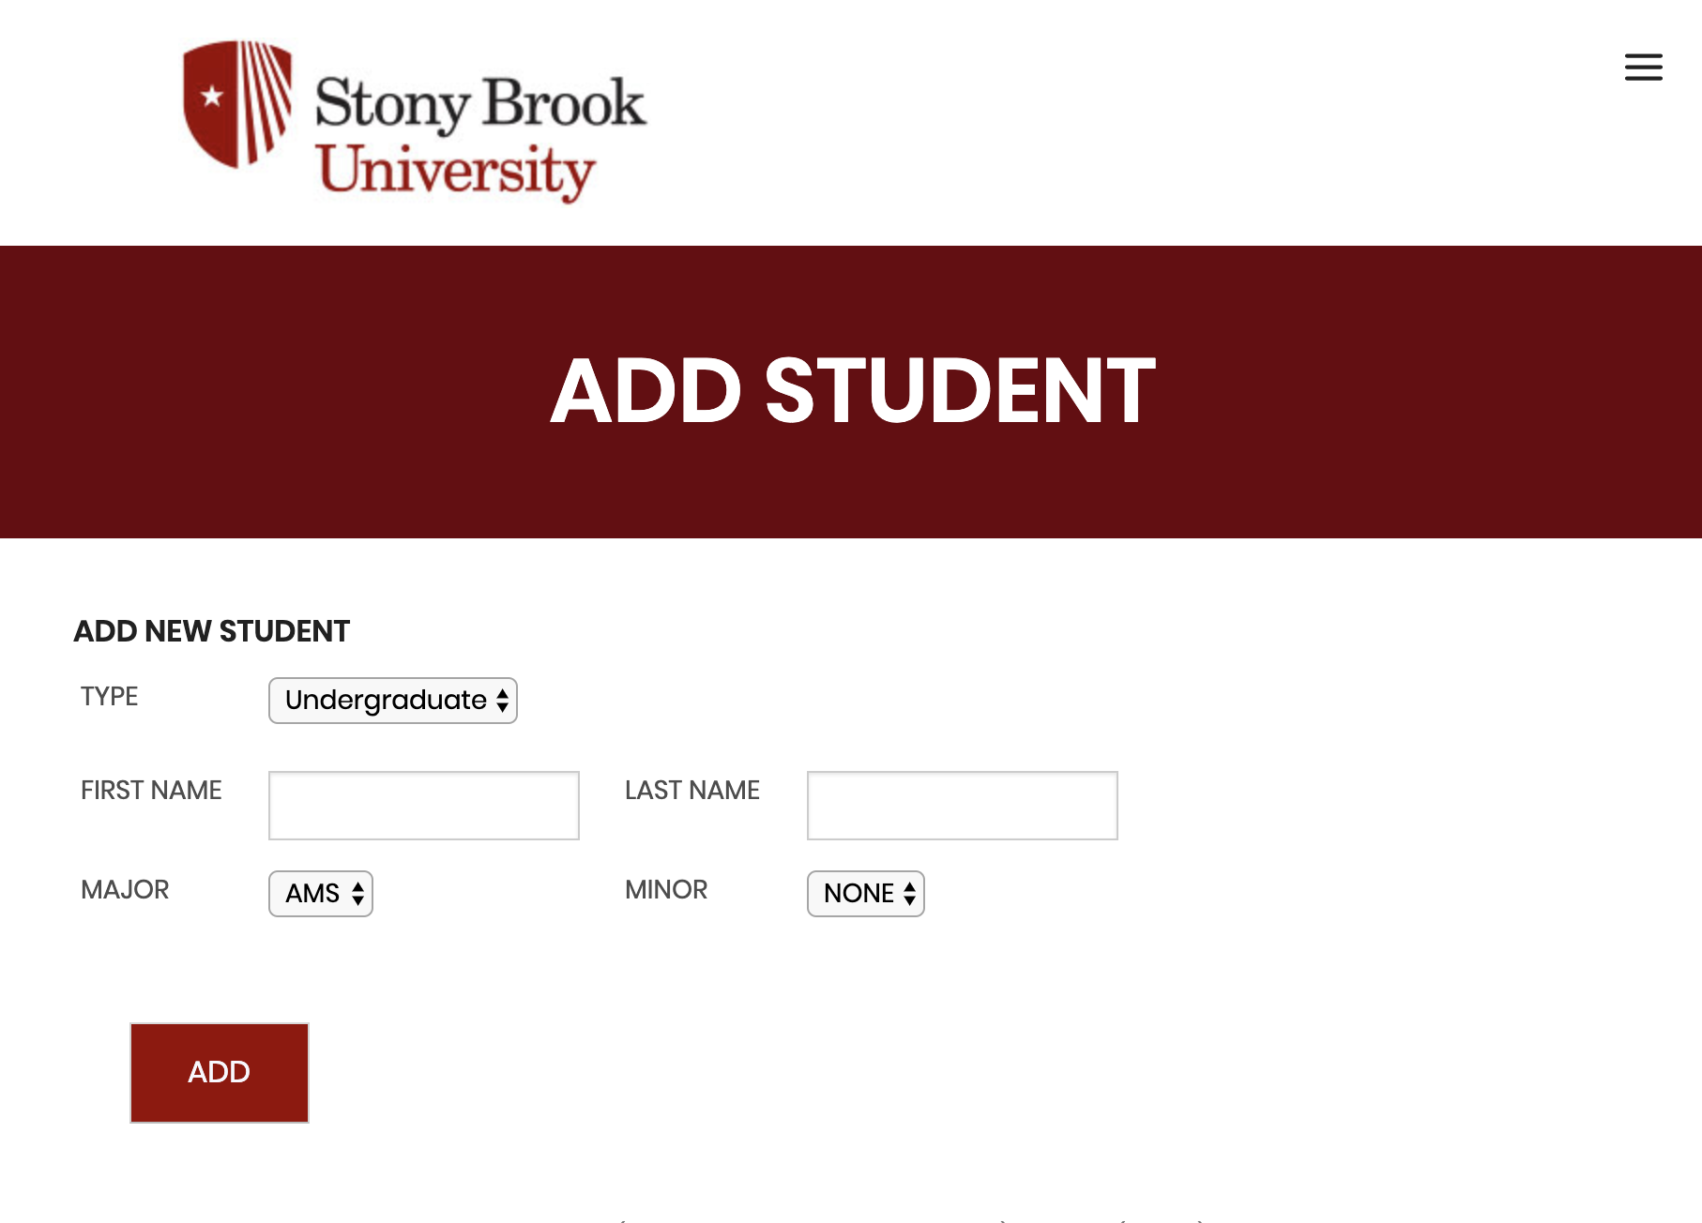
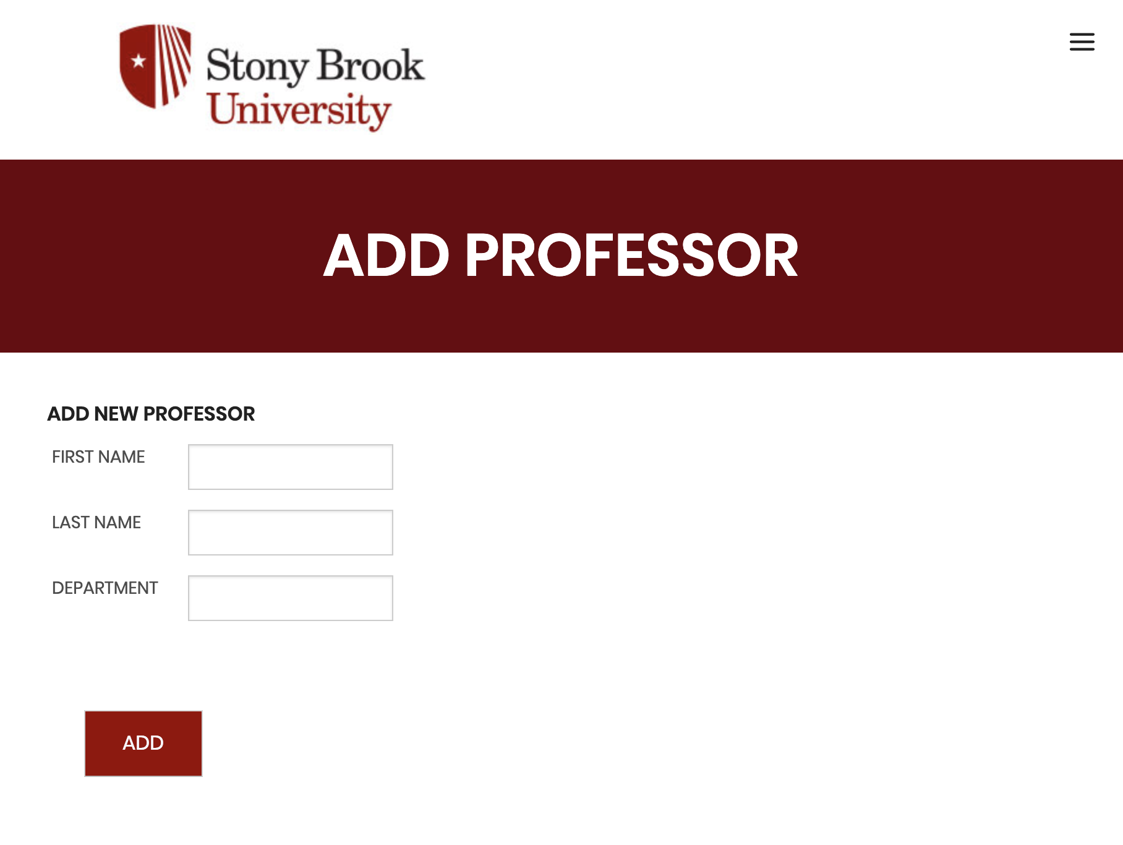
Demo:
Notes:
Domain info of your system (what sort of database app are you building?)
E/R diagram Initial set of tables with FD's Normalization done showing resulting tables Key database features in your system Demo of your system in operation (implementation should be close to being complete)

Slide 13
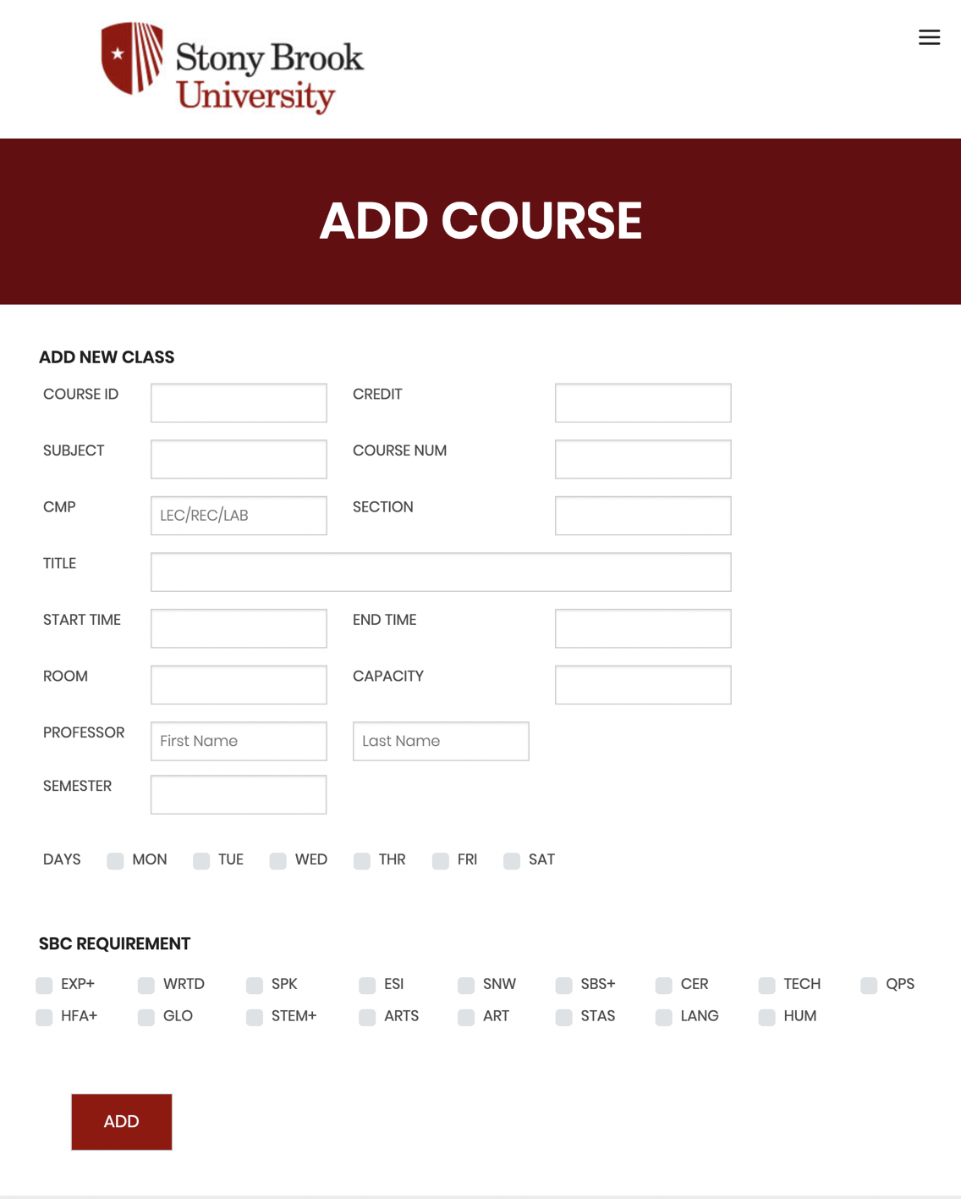
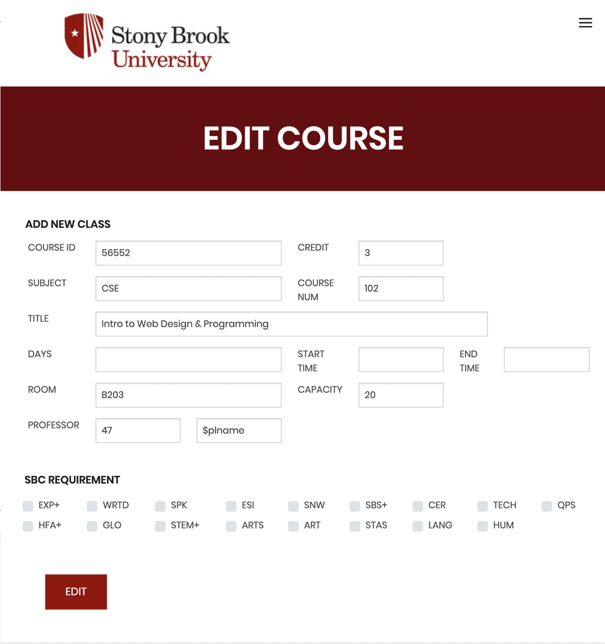
Notes:
Domain info of your system (what sort of database app are you building?)
E/R diagram Initial set of tables with FD's Normalization done showing resulting tables Key database features in your system Demo of your system in operation (implementation should be close to being complete)

Slide 14

Demo:
Notes:
Domain info of your system (what sort of database app are you building?)
E/R diagram Initial set of tables with FD's Normalization done showing resulting tables Key database features in your system Demo of your system in operation (implementation should be close to being complete)

Slide 15
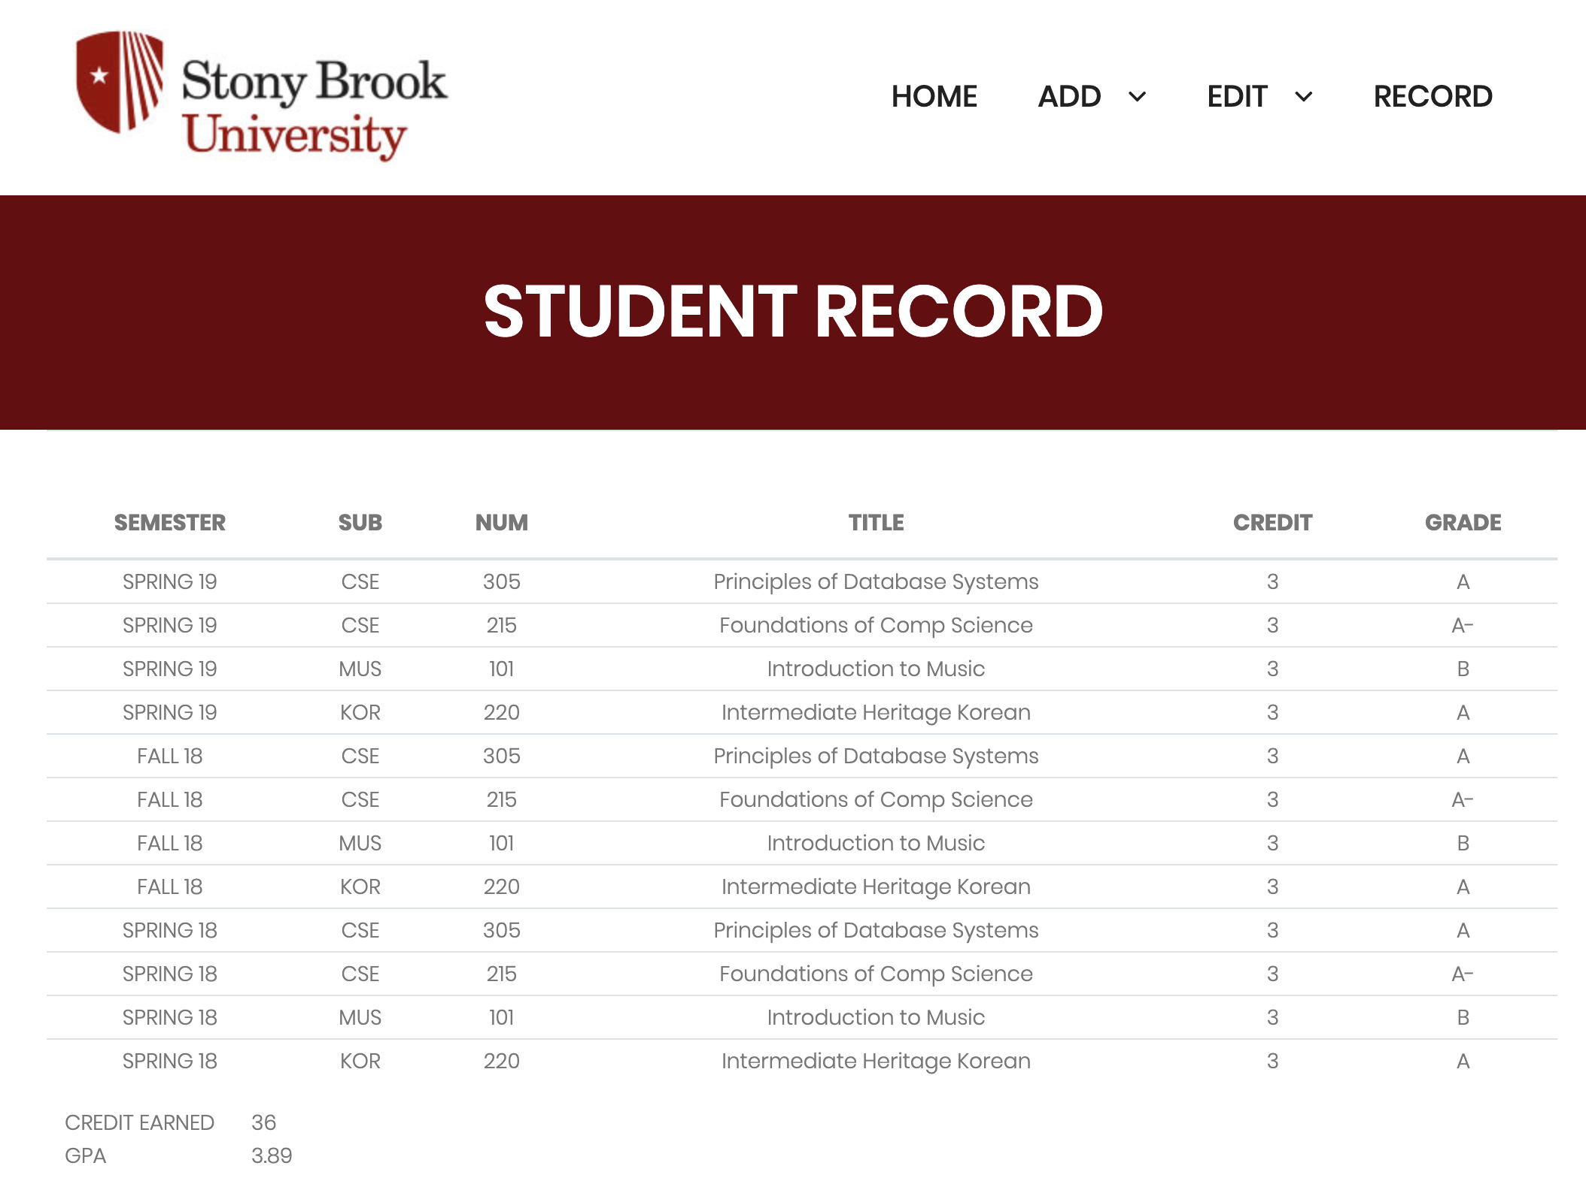
Notes:
Domain info of your system (what sort of database app are you building?)
E/R diagram Initial set of tables with FD's Normalization done showing resulting tables Key database features in your system Demo of your system in operation (implementation should be close to being complete)

Slide 16

Demo:
Student
Notes:
Domain info of your system (what sort of database app are you building?)
E/R diagram Initial set of tables with FD's Normalization done showing resulting tables Key database features in your system Demo of your system in operation (implementation should be close to being complete)

Slide 17
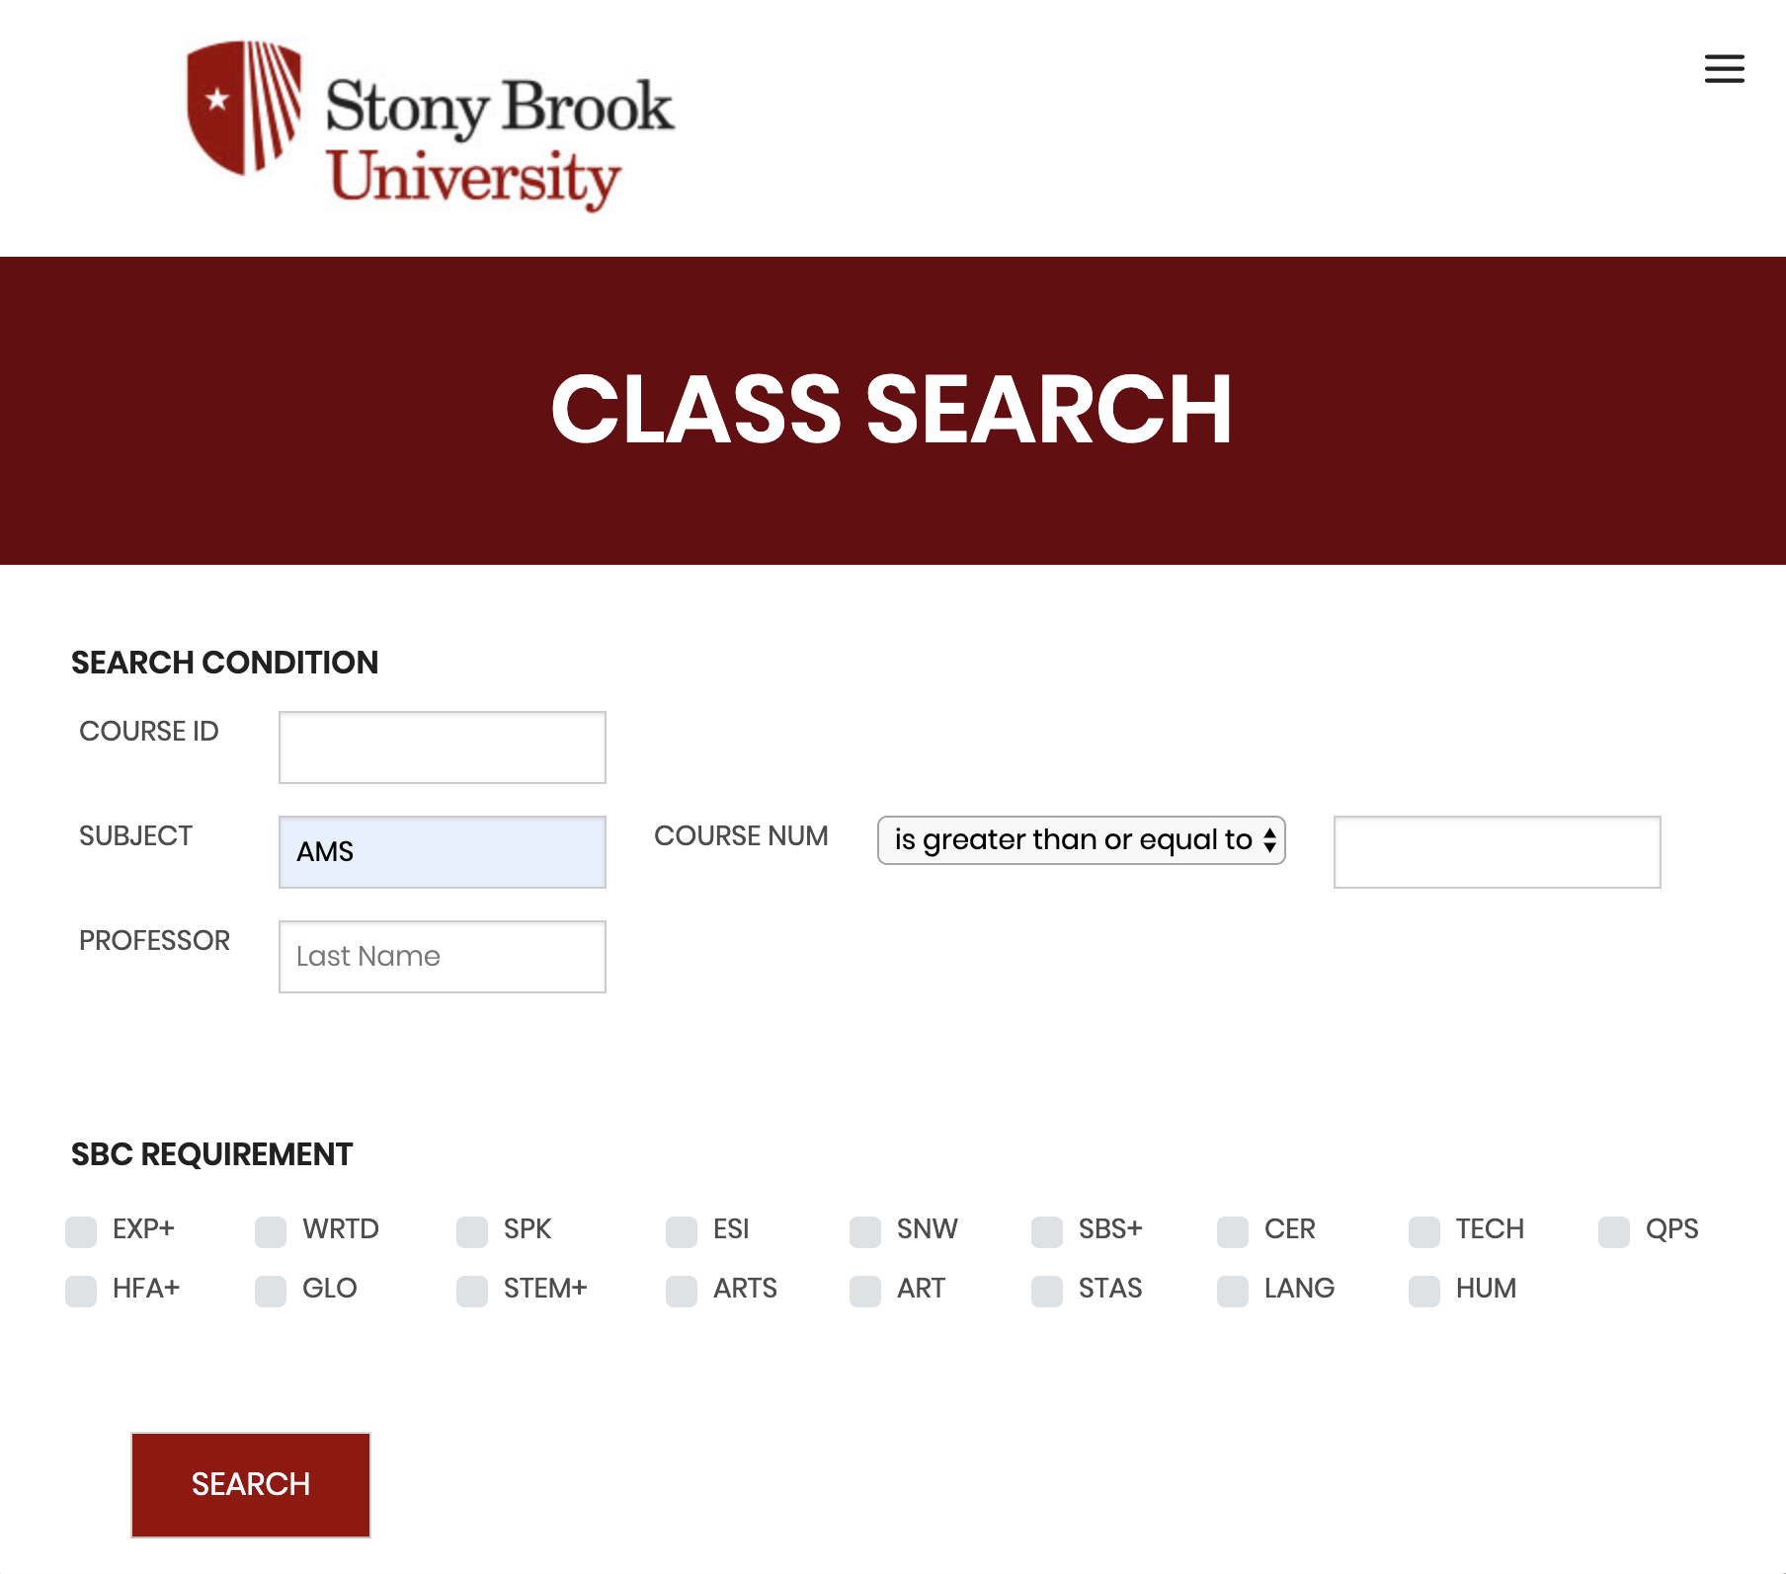
Demo:
Notes:
Domain info of your system (what sort of database app are you building?)
E/R diagram Initial set of tables with FD's Normalization done showing resulting tables Key database features in your system Demo of your system in operation (implementation should be close to being complete)

Slide 18

Demo:
Notes:
Domain info of your system (what sort of database app are you building?)
E/R diagram Initial set of tables with FD's Normalization done showing resulting tables Key database features in your system Demo of your system in operation (implementation should be close to being complete)

Slide 19
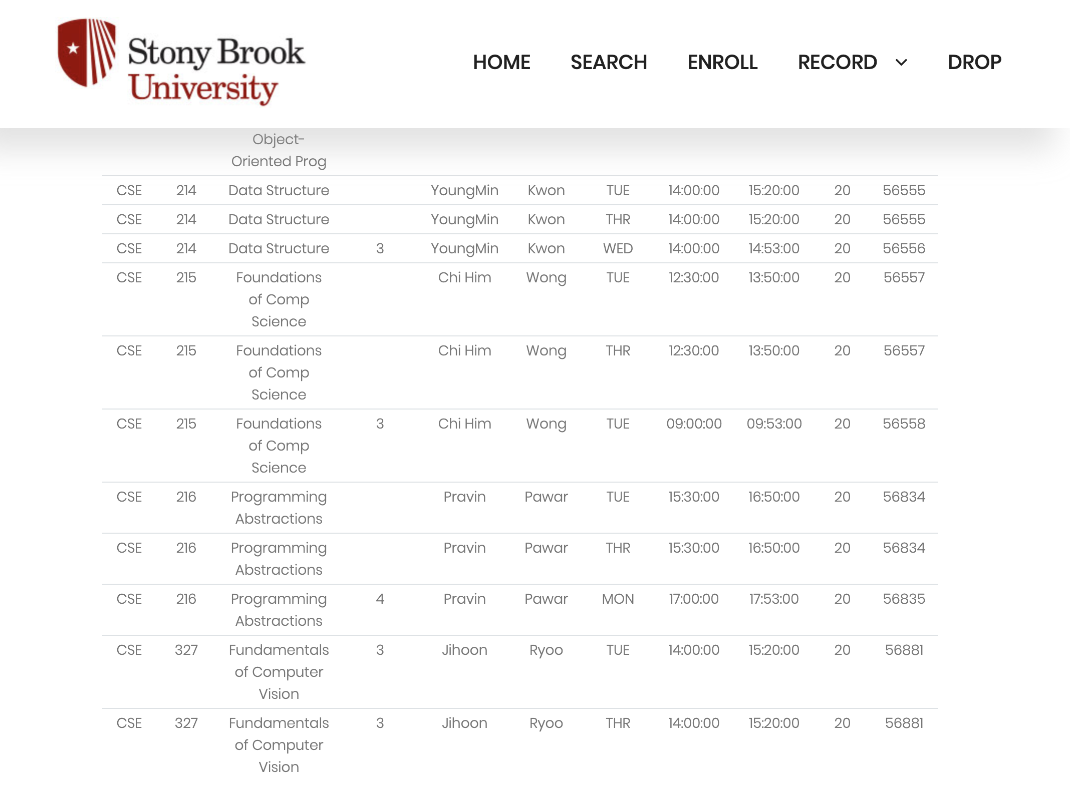
Notes:
Domain info of your system (what sort of database app are you building?)
E/R diagram Initial set of tables with FD's Normalization done showing resulting tables Key database features in your system Demo of your system in operation (implementation should be close to being complete)

Slide 20
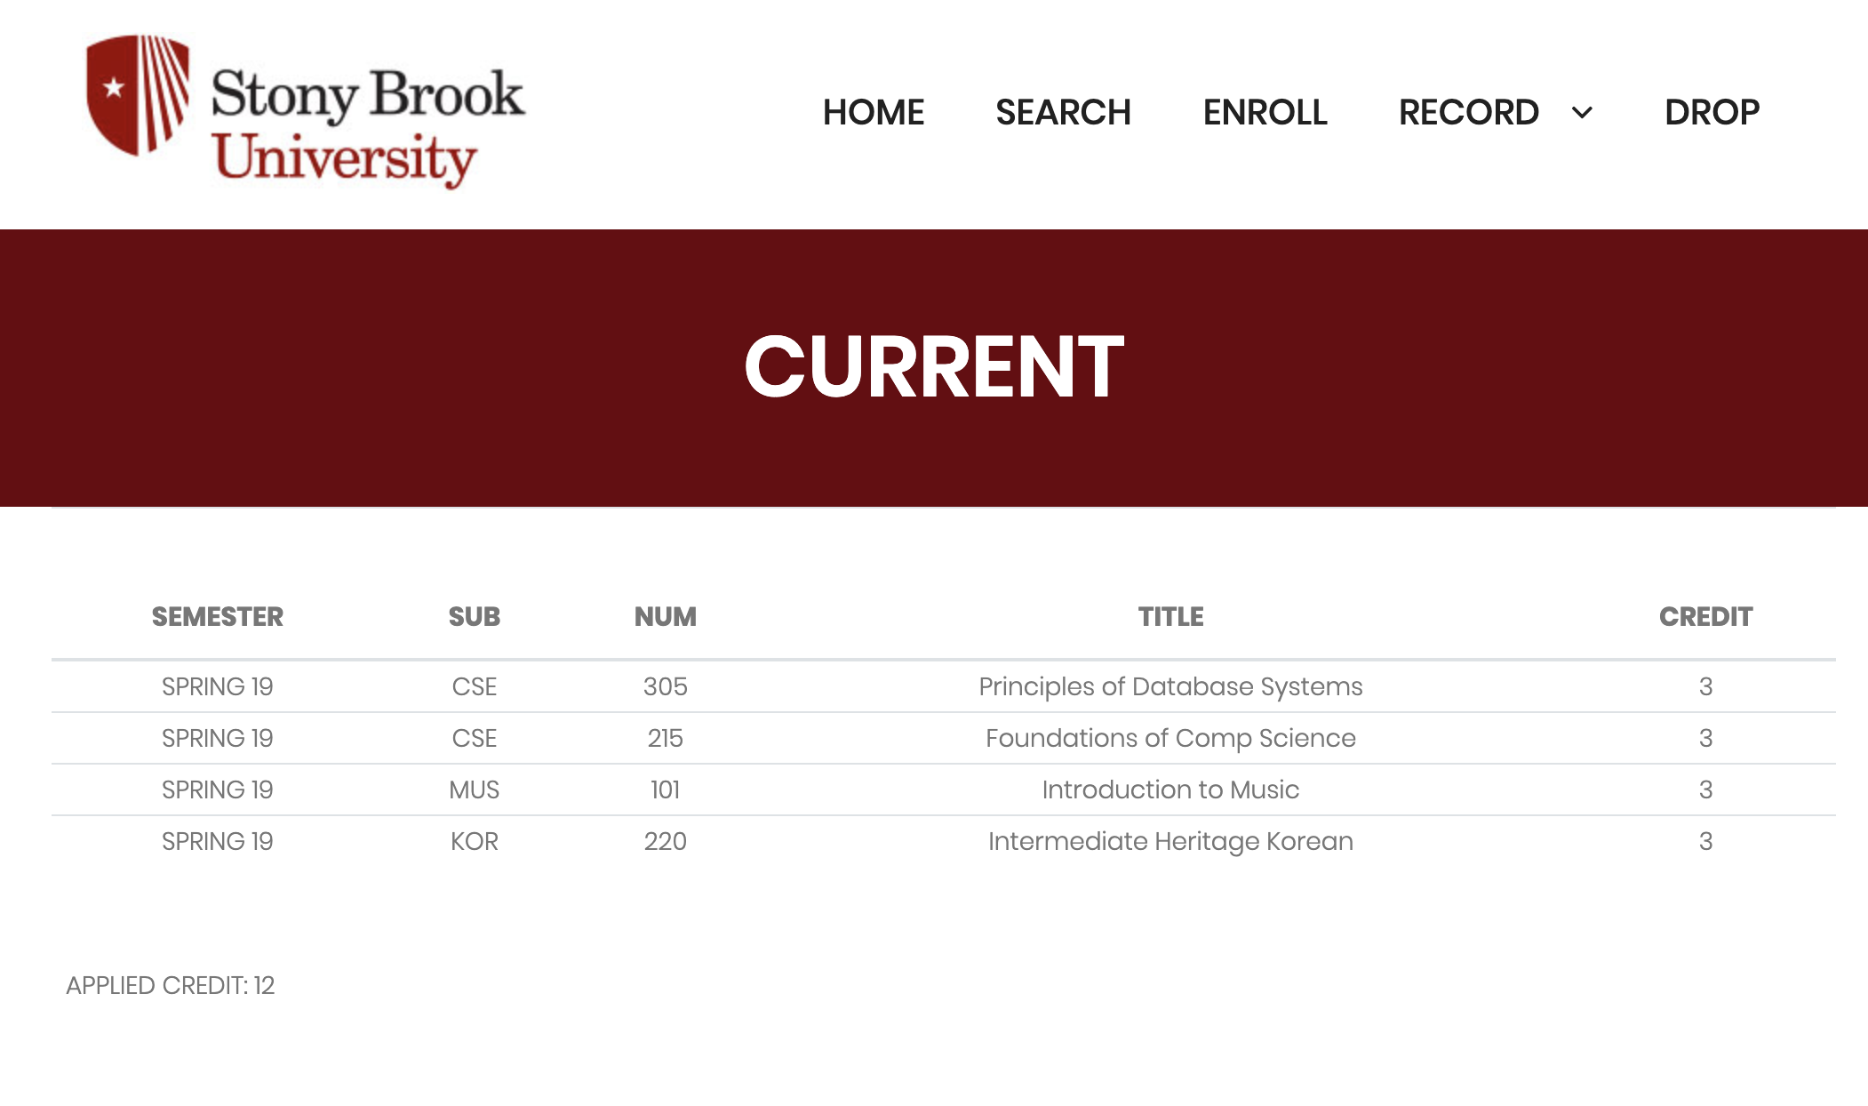
Demo:
Notes:
Domain info of your system (what sort of database app are you building?)
E/R diagram Initial set of tables with FD's Normalization done showing resulting tables Key database features in your system Demo of your system in operation (implementation should be close to being complete)

Slide 21
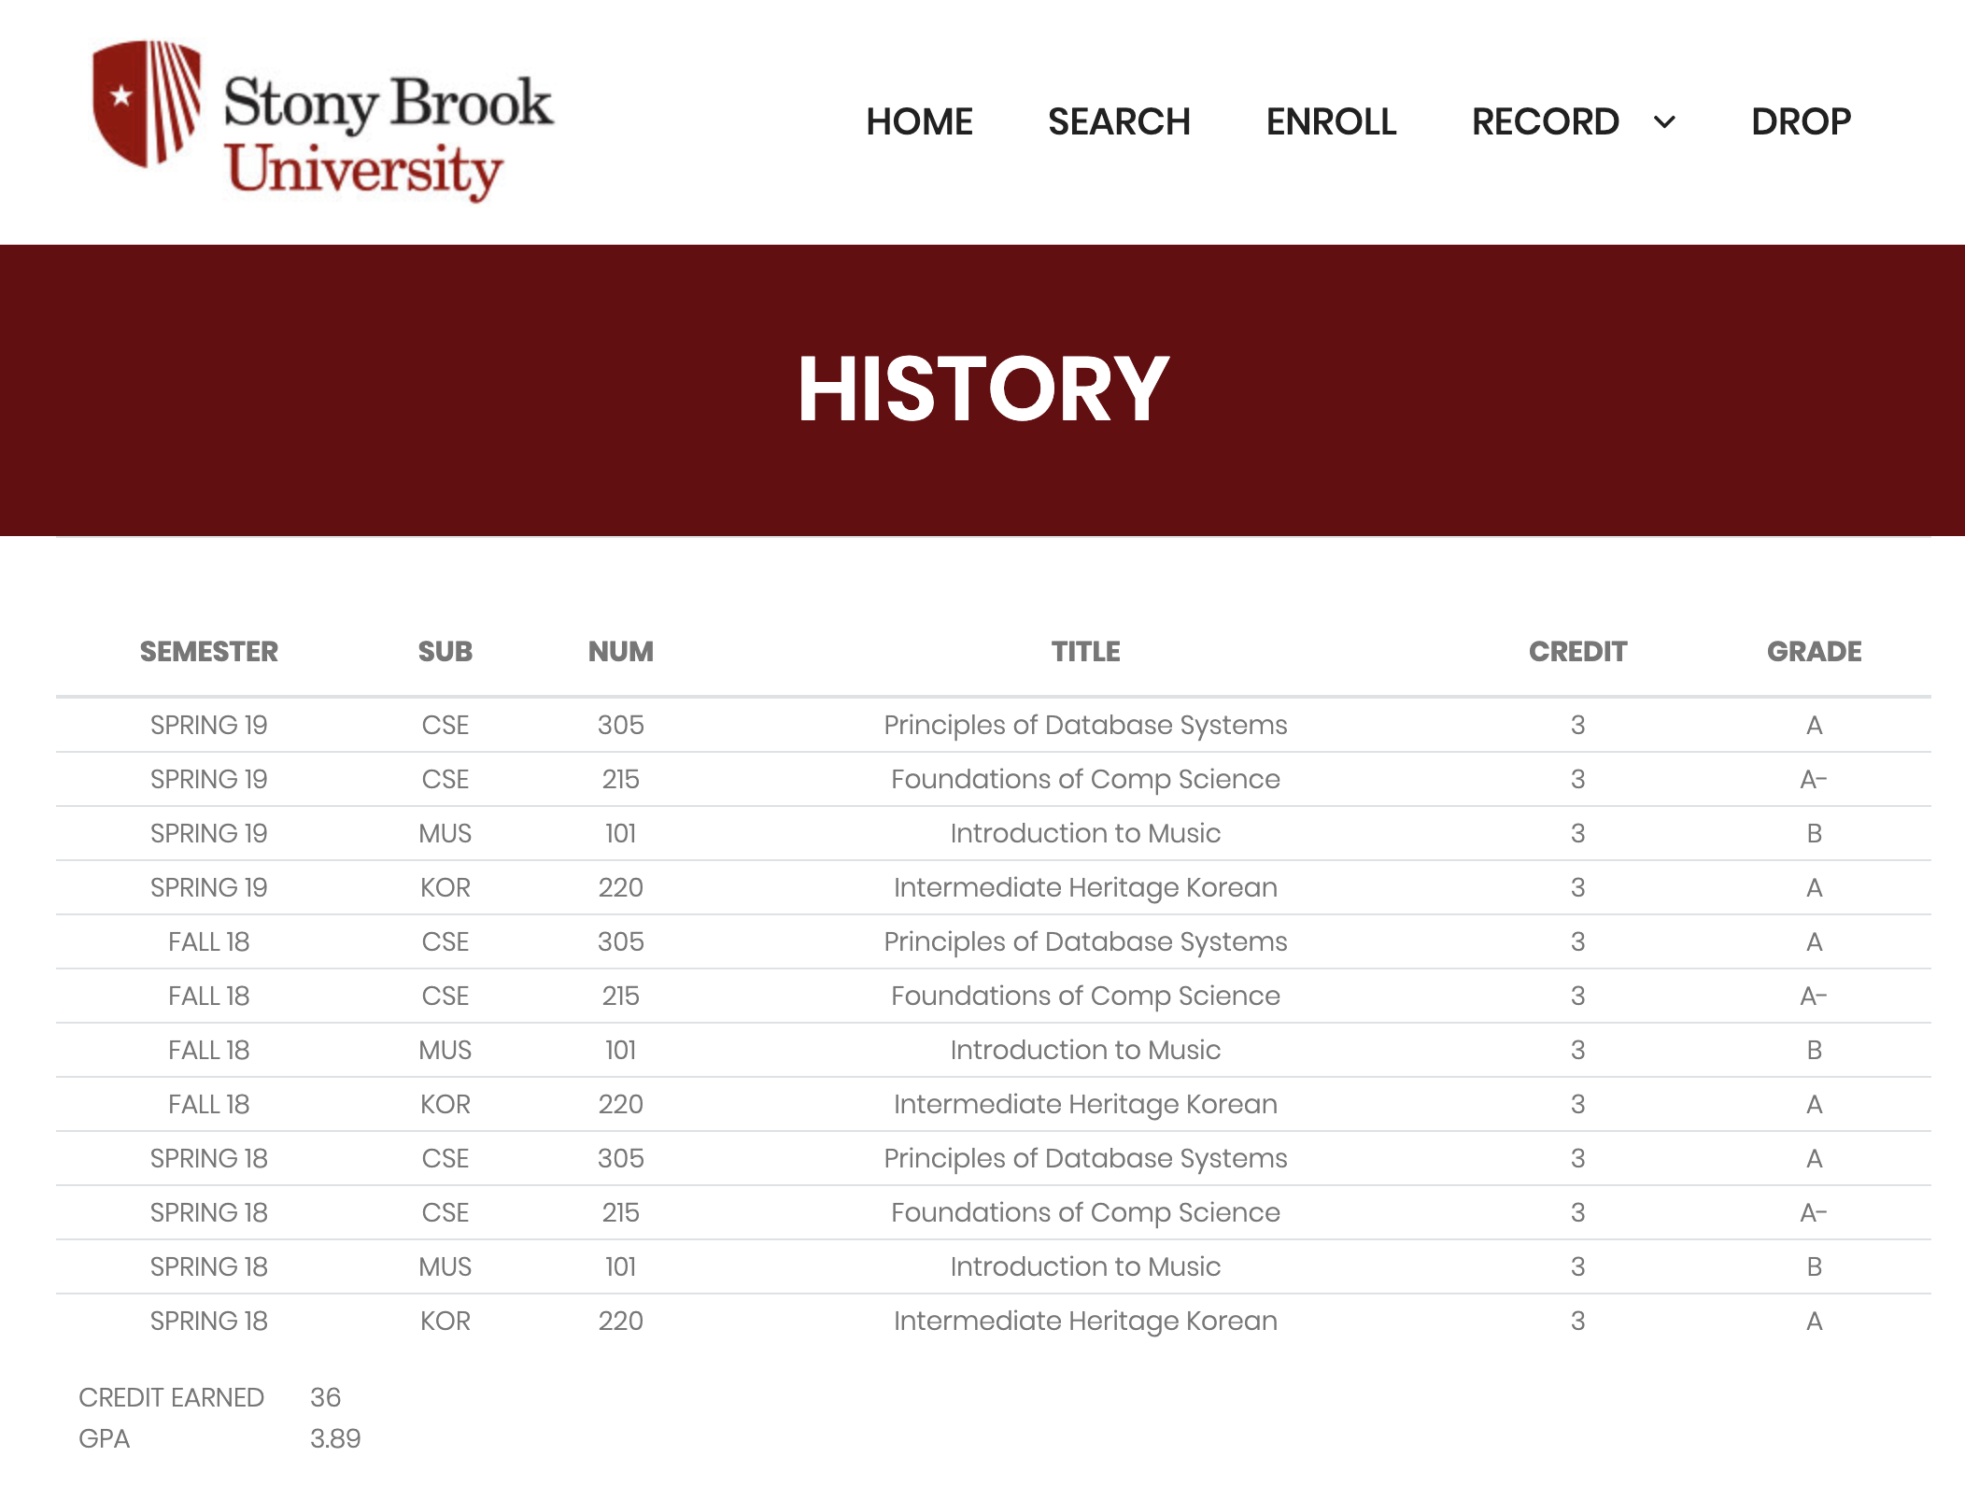
Notes:
Domain info of your system (what sort of database app are you building?)
E/R diagram Initial set of tables with FD's Normalization done showing resulting tables Key database features in your system Demo of your system in operation (implementation should be close to being complete)

Slide 22

Demo:
Notes:
Domain info of your system (what sort of database app are you building?)
E/R diagram Initial set of tables with FD's Normalization done showing resulting tables Key database features in your system Demo of your system in operation (implementation should be close to being complete)

Slide 23
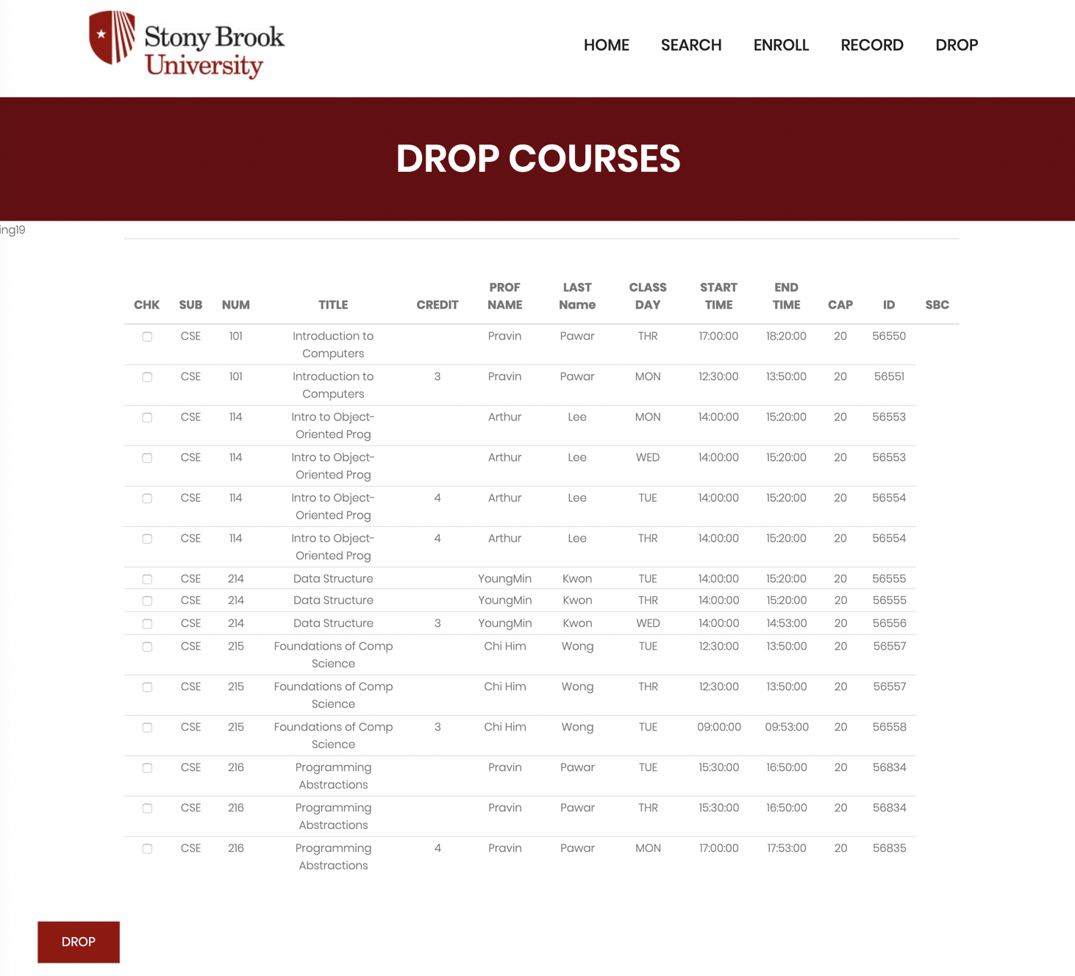
Notes:
Domain info of your system (what sort of database app are you building?)
E/R diagram Initial set of tables with FD's Normalization done showing resulting tables Key database features in your system Demo of your system in operation (implementation should be close to being complete)

Slide 24
Questions?

Slide 25
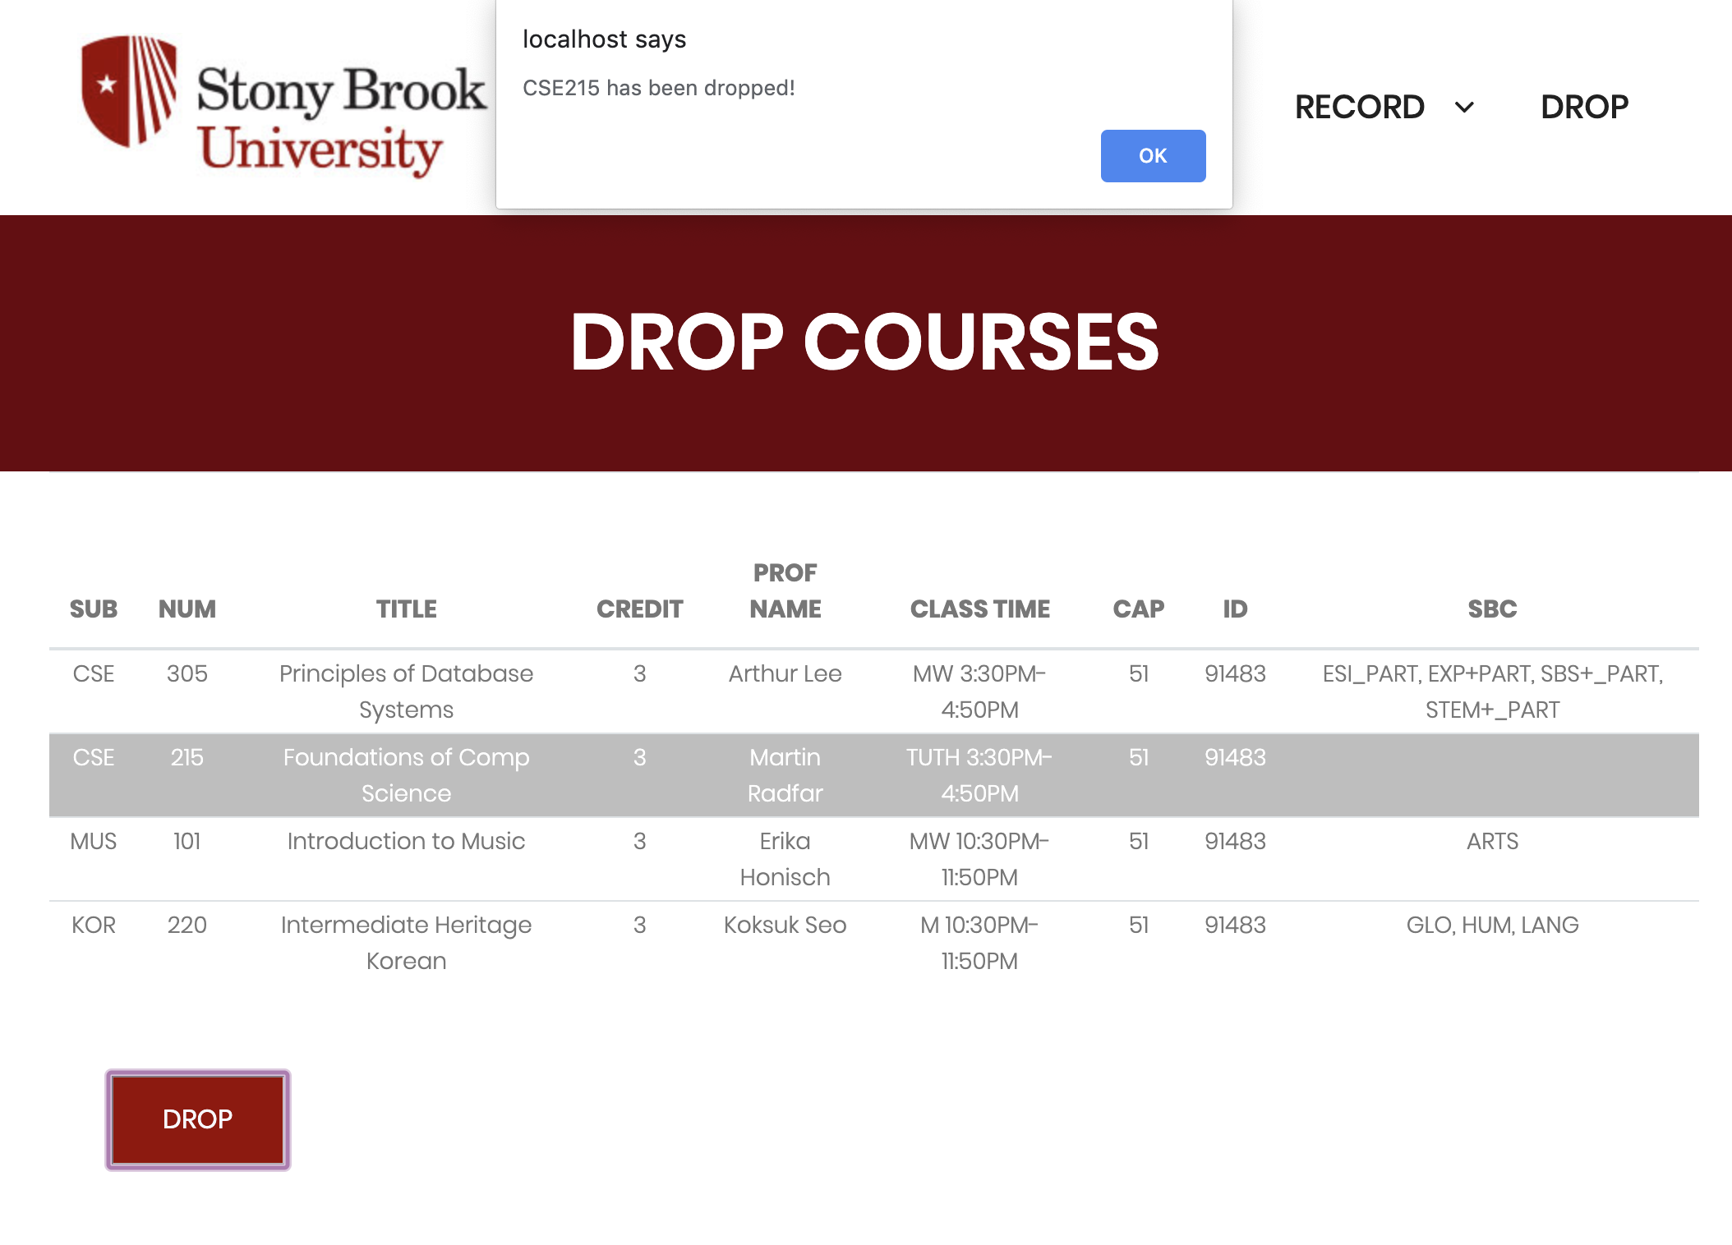
Notes:
Domain info of your system (what sort of database app are you building?)
E/R diagram Initial set of tables with FD's Normalization done showing resulting tables Key database features in your system Demo of your system in operation (implementation should be close to being complete)

Slide 26
Normalidfdzation:
Personal Information
Any information related to a living natural person who can be identified/identifiable from it
Direct information: name, resident registration number, image)
Indirect information: identify a specific individual combined with other information.
Sensitive Information
ideology, belief, admission/exit to/from trade unions or political parties, political mindset, health, sexual life, etc.
Personal Information Controller
A public institution, legal person, organization, individual, etc.
Processes directly/indirectly personal information to operate personal information files for official/business purposes
Notes:
Domain info of your system (what sort of database app are you building?)
E/R diagram Initial set of tables with FD's Normalization done showing resulting tables Key database features in your system Demo of your system in operation (implementation should be close to being complete)

